Slide 1

Speaking freely -The first amendment’s protection of modern media
Lawrence G. Walters, Esq.
www.FirstAmendment.com
800.530.8137
@WaltersLawGroup

Slide 2

Some questions
Is “hate speech” illegal?
Can you possess obscene material in your home?
Is Facebook or Twitter responsible if their users promote sex trafficking or terrorism?
Are bullfighting videos illegal?
Is computer code protected speech?
Can a 17 year-old girl who takes a nude selfie go to jail for producing child pornography?

Slide 3
Overview of First Amendment protections
Why is the First Amendment Important?
The growing role of content production in every day life
Historically broad interpretation of rights in the courts
All speech is presumed to be protected

Slide 4
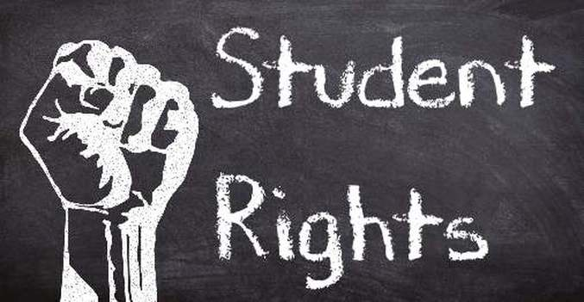
Does the First Amendment apply to students?
Tinker v. Des Moines Independent Community School
Private v. public schools
Do students know their rights?
Overly-Narrow view of First Amendment protections
Most agree that offensive speakers can be shut down – even with violence
Most believe that opposing viewpoints are required

Slide 5
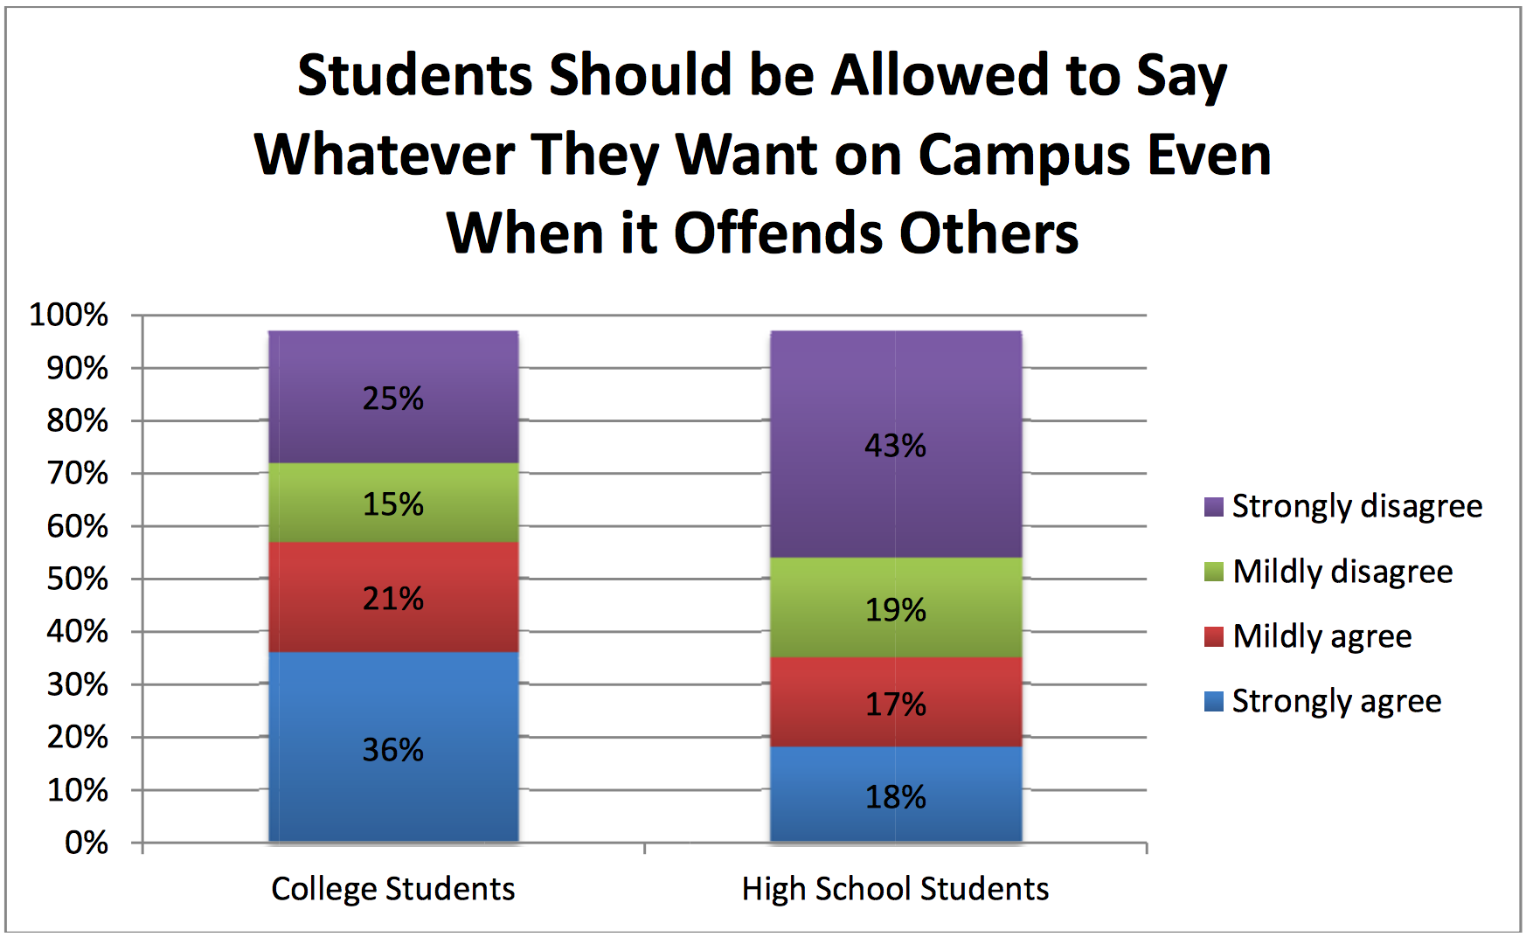
State of the First Amendment Survey, Newseum (2016)

Slide 6
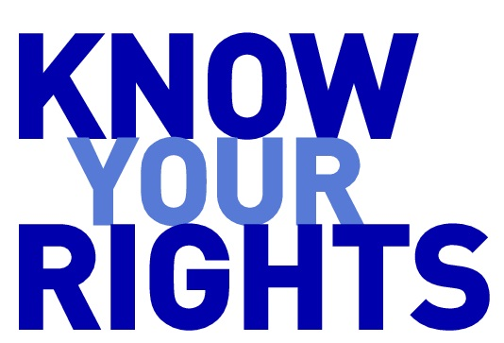
-39% of Americans cannot name a single right protected by the first amendment -Less than half identified freedom of speech as a first amendment right University of Pennsylvania, Annenberg Public Policy Center Poll (2017)

Slide 7

What material does the first amendment protect?

Slide 8

Books / text / writings
Primary focus of 1st Amendment
Difference between obscenity & profanity?
Cohen v. California
Banned Books
The Adventures of Huckleberry Finn
The Call of the Wild
The Catcher in the Rye
Fahrenheit 451
The Great Gatsby

Slide 9
U.S. v. Karen fletcher
“A Prosecution Tests the Definition of Obscenity”
Federal obscenity charges against red rose stories website
Text only – no images
First case in over 30 years
Settled to avoid public trial

Slide 10

Pictures / movies / graphic arts
Censorship Review Boards
Development of the “Prior Restraint” Doctrine
All Motion Pictures, Magazines, & Digital Pictures are presumed to be protected
Voluntary MPAA Ratings System

Slide 11
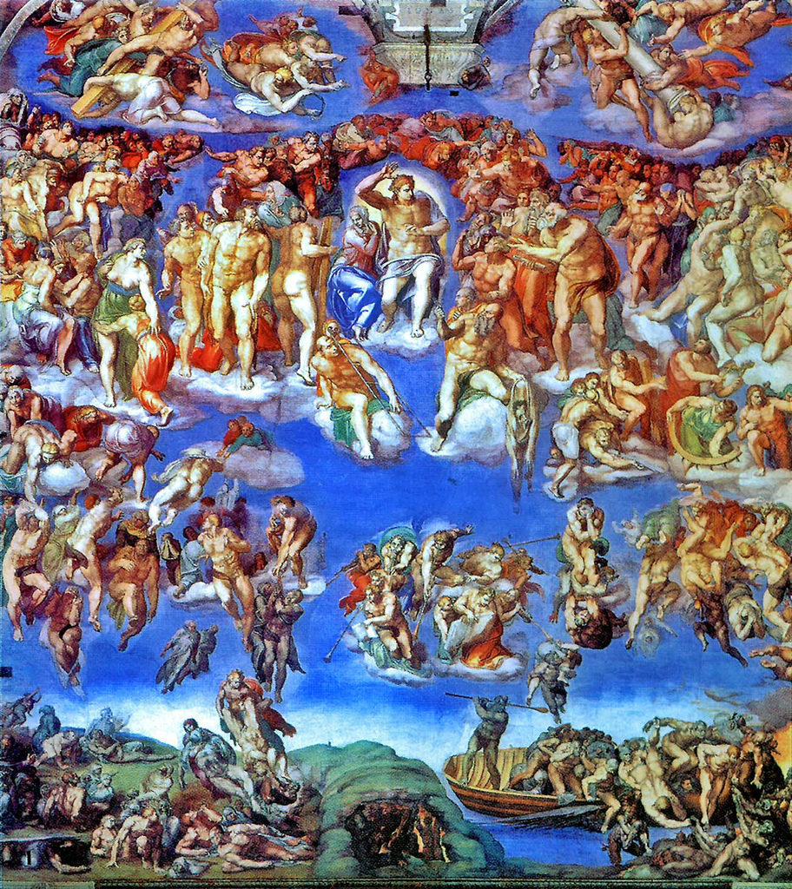
Artwork Michelangelo’s “The last judgEment”

Slide 12


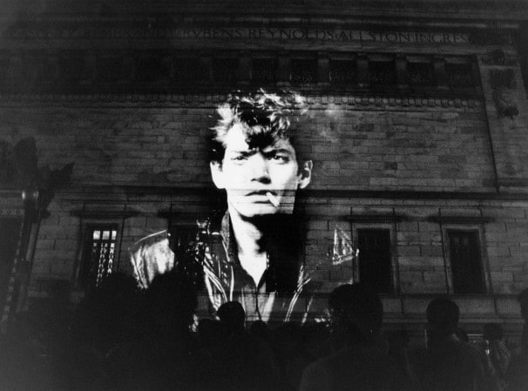
Artwork Robert Mapplethorpe -The Perfect Moment

Slide 13

Artwork Nudist peace sign
Created on Valentine’s Day, 2003 on McArthur State Beach Park
DEP demanded that bathing suits be worn
Organizers sued in federal court
court issued preliminary injunction finding First Amendment protection
Conduct was designed to send an anti-war message

Slide 14
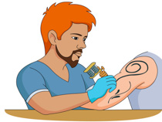
Tattoos
Protected Speech?
Southernmost Tattoo Parlor files suit
Court holds tattoos are protected speech (2017)
City pays owner $425,000 to settle

Slide 15
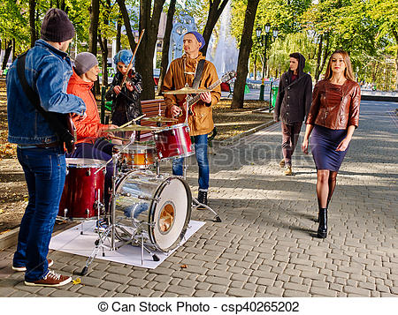
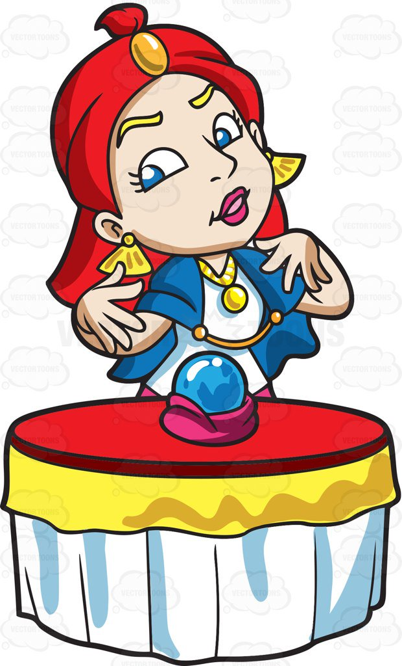

Live Performances
Protests
Plays
Street Performers
Nude Dancing
Fortune Tellers

Slide 16

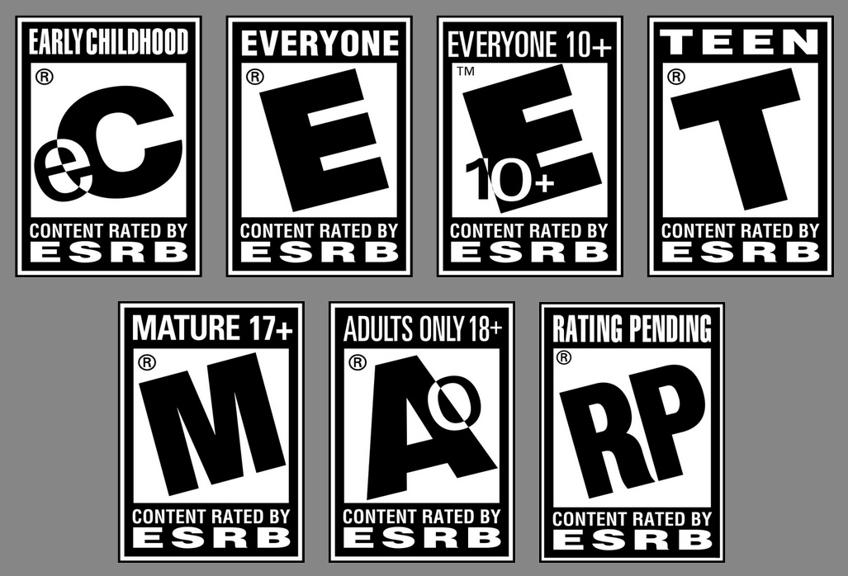
Video Games
The long road to protected expression
Free speech protection recognized in Brown v. Entertainment Merchants Assn (2011)
Voluntary ESRB video game labeling system
New concerns raised after Parkland shooting

Slide 17

Websites
Website content is protected speech
Website Domains?
Not speech – more like a street address or telephone number
Search Engine Results?
The battle continues
Special Legal Protection for User Generated Content Websites
Restricting minors from accessing adult content
CDA
COPA
State Laws

Slide 18

Advertisements
Protection of Commercial Speech uses a different test
Central Hudson Test
Tobacco Ad Disclosures
Surgeon General Warning
Graphic Disclosures
Challenged on First Amendment Grounds – Held Unconstitutional (DC. Cir.)
Gambling Advertisements
Third-Party Advertisements

Slide 19

Computer Code
Has speech-like qualities
Encryption case treats code as speech
Bernstein v. DOJ (1999)
Encryption code is speech, not munitions regulated by DOJ
Source code v. object code debate
Apple iPhone unlock demand by DOJ – Forced Speech issue
If code is speech, are viruses also protected?

Slide 20
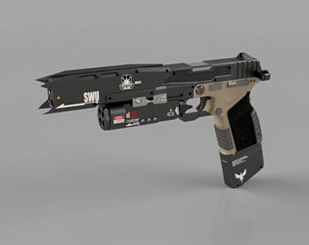
1St Amendment, 2nd Amendment, 3D Guns
CAD files can print an unidentifiable weapon
DOJ categorizes CAD files as “Munitions” and regulated
Defense Distributed posted files – “Liberator” weapon downloaded over 100,000 times in 2 days
Challenged and upheld on national security grounds
Defense Distributed v. U.S. Department of State (2016)
Public’s Interest in “safety” outweighed First Amendment rights

Slide 21

Artificial intelligence
Can information not created by humans be speech?
Who owns the speech (or “Do robots have rights?)
Legal status unsettled
Focus on the value of the expression to human listeners

Slide 22

Filming the police
Is recording police activity in public protected?
Eavesdropping / wiretapping laws
Most courts provide first amendment protection
Police argue it can interfere with their law enforcement functions
Poised for resolution by Supreme Court

Slide 23
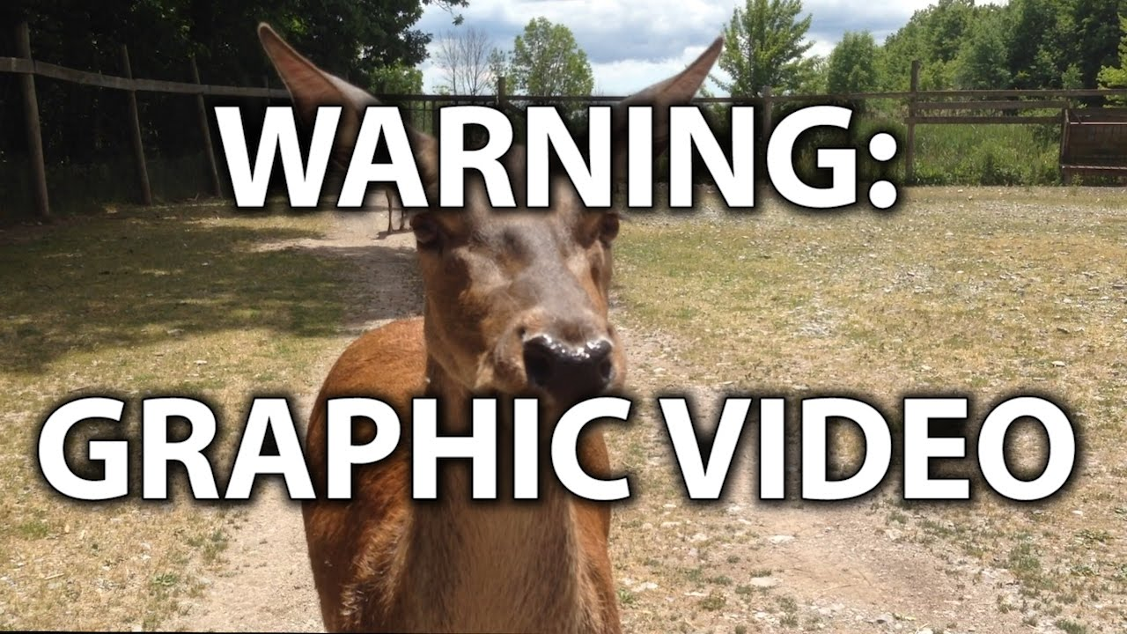
Animal cruelty depictions
Crime in every state
Is possession or distribution of recording protected?
Congress passes a law focused on ‘crush videos’
Challenged and heard by the Supreme Court
Broad law could cover bullfighting and hunting out of season
Declared unconstitutional – U.S. v. Stevens (2010)

Slide 24

Lies
Protected speech in most circumstances
Stolen Valor case
Exceptions
Defamation
Commercial Speech (misleading advertisements)

Slide 25
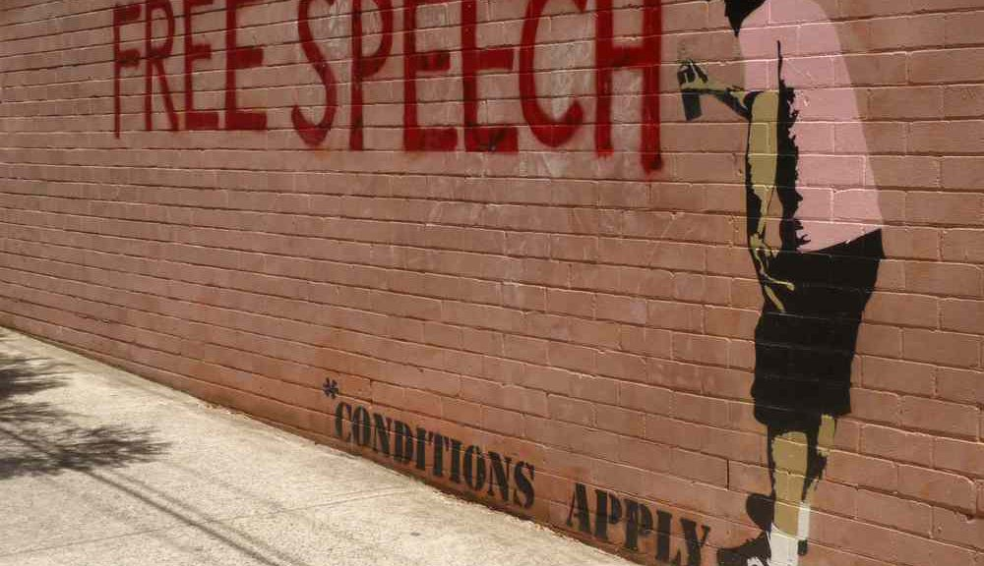
Exceptions to First Amendment Protection
Congress shall make “No Law”
Narrowly drawn, historical categories of unprotected speech
No new categories accepted since 1981 (child pornography)
Numerous attempts
Current Court protective of broad First Amendment protection

Slide 26


Obscenity
The Miller Test
Sexual Conduct (not violence)
Patently Offensive
Appeals to the prurient interest in sex
Lacks serious literary, artistic, political, or scientific value
Problems with the “Local Community
Specific Cases
Website Content (the “work as a whole”)
Comic Books (really?)
User generated content

Slide 27

Child Pornography
Constitutional status not established until 1982
Pandering or promoting underage content also illegal even if not real
“Virtual” underage content (young-looking adults) not illegal per U.S. Supreme Court (FSC v. Ashcroft)
Illegal content includes fully-clothed minors
Legal issues with morphed images
Problems with teen sexting and self-production

Slide 28
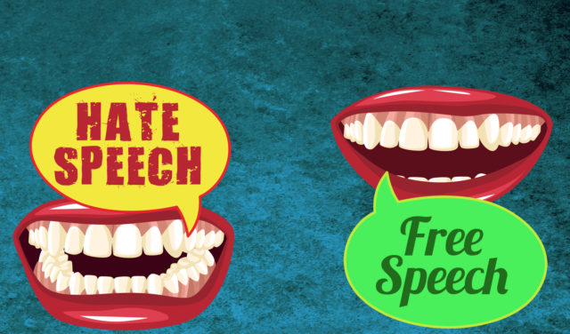
Incitement to Violence
Must induce imminent lawless action
Not the same as “hate speech”
Discussing violence is not the same as incitement to violence

Slide 29
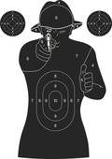
True Threats
Different from generalized threats
Different from conditional threats
Social media postings as treats
Threats in School

Slide 30


Defamation
Use of courts to punish speech = First Amendment concern
Defamation limited to publication of false statements of act that cause damages
Numerous defenses and privileges
Truth
Litigation privilege
Conditional/qualified privilege
Hyperbole
Substantial truth
Practical concerns with using the legal system to fight defamation
“Streisand Effect”
Legal expenses
Anti-SLAPP laws

Slide 31
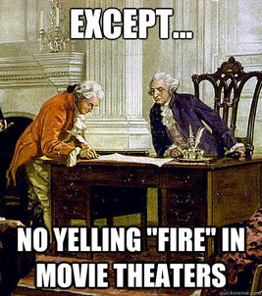
Verbal Acts / Criminal Conduct
“Fire in a crowded theater”
Sexual harassment
Solicitation (murder / prostitution)
Insider trading

Slide 32

National Security
Based on protecting national secrets
Exception subject to abuse
Pentagon Papers case

Slide 33
Free speech issues with social media
Private v. Government Censorship
Truth in Advertising Legislation
FEC Regulations of Political Ads
Online Reviews
Revenge Porn
Facilitating Extremism
Sex Trafficking / Prostitution

Slide 34
Threats to the First Amendment
Lack of understanding / knowledge
Willingness to surrender valuable liberties
Surveillance State – Chilling effect on speech and thought
Abuse of First Amendment rights

Slide 35



Get Involved
Foundation for Individual Rights in Education – thefire.org
Students’ Rights, Speech Codes, Protests
Electronic Frontier Foundation – eff.org
Digital Freedom, Security, and Privacy
Center for Democracy & Technology – cdt.org
Internet Freedom

Slide 36
Questions?

