Slide 1

NSA Surveillance -chilling free expression
Rally Against Mass Surveillence
StopWatching.Us
Saturday, October 26, 2013
Presented By: Lawrence G. Walters, Esq.
of Walters Law Group
www.FirstAmendment.com

Slide 2
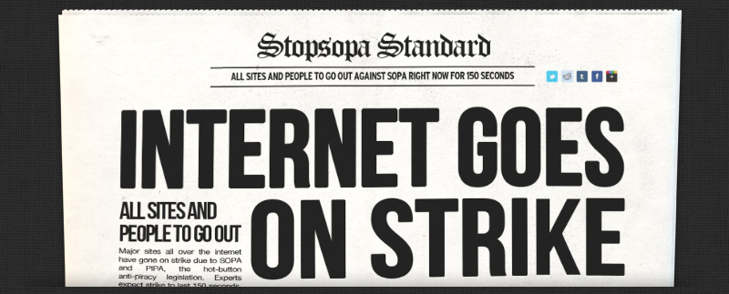
Historical Internet Protest SOPA & PIPA Stopped (January 18, 2012)

Slide 3

An Emerging Threat: The NSA
Edward Snowden uncovered what many feared to be true. Our government was spying on its own citizens, and intercepting their communications.
ATT& Verizon have essentially opened their systems to the NSA investigators.
Facebook, Microsoft & Google have cooperated at some level, but deny any ‘back door’ access. Request release of FISA opinions.

Slide 4
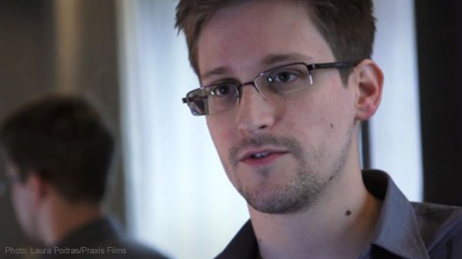
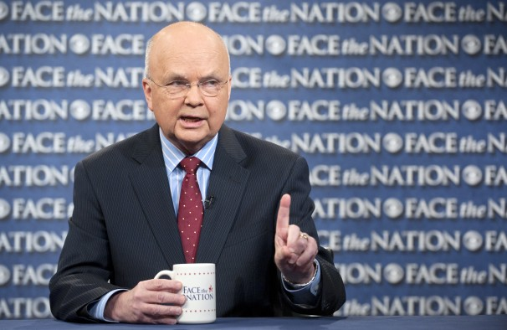
Edward Snowden Whistleblower or Traitor?
NSA Chief (Former) Michael Hayden says Snowden is “morally Arrogant” and will end up an “Alcoholic”
ACLU says Snowden is clearly a “whistleblower” under federal law

Slide 5
Whistleblower Protection act
* Federal law protects "any disclosure" that a covered employee reasonably believes evidences "any violation of any law, rule, or regulation," or "gross mismanagement, a gross waste of funds, and abuse of authority, or a substantial and specific danger to public health or safety.“
* Lawmakers have called the NSA domestic spying program “incredible troubling” and an “overbroad interpretation” of the Patriot Act.

Slide 6
What does the NSA Track?
Content of emails. (WSJ.com)
Metadata of phone calls. (Id.)
Google / search engine searches (A.P. Post)
Content of phone calls (WSJ.com.)
Credit Card Transactions
In 2011 the NSA database contained 180 million records, with 84 percent of those being credit card transactions details. (Snowden leak)
Used by NSA’s “Follow the Money” (FTM) Branch.
75% of All Internet Traffic (WSJ.com)

Slide 7
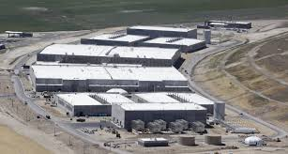
Where is the Data Stored?
Bluffdale, Utah data center will have the ability to collect all worldwide electronic communications and transactions

Slide 8
Data Center Specs
One million square feet in size
Power bill: $70 million per year.
Storage estimates range from “yotabytes” (Wired) to 5 “zetabytes” of data, which can be stored indefinitely. (NPR)
Conversion: yottabyte = 1,000 zettabytes = 1,000,000 exabytes = 1 billion pettabytes = 1 trillion terabytes.
The entire internet is only 1% of a yotabyte
Only 400 terabytes needed to hold all of the books ever written in any language.

Slide 9
Informed Speculation
Some estimates indicate the data center could easily hold hypothetical 24-hour video and audio recordings of every person in the United States for a full year. (Forbes.com)
The NSA data center will accumulate private interactions and information and make them searchable, similar to the Internet Archive’s Wayback Machine. (Brewster Kahle, creator of archive.org)
William Binney, a former employee of the NSA turned whistleblower, believes the agency is guilty of unconstitutional information gathering on American citizens, and that the sheer size of the data centers in Utah and elsewhere suggests that the agency wants to vacuum up “everything it can, including all the content of people’s phone calls and emails.”

Slide 10







It Gets Worse… The NSA is expanding rapidly

Slide 11
NSA Expansion
NSA Footprint will grow by 50% by the end of the decade. (Washington Post)
NSA has enlarged all its major domestic sites — in Colorado, Georgia, Hawaii, Texas and Utah — as well as those in Australia and Britain.
60 percent of the president’s daily intelligence briefing comes from the NSA. Percentage is growing.
NSA capabilities now used to kill single individuals using geo-tracking of communications devices.
Current NSA Motto: “We Track ’Em, You Whack ’Em.”

Slide 12
Is there any abuse?
NSA Employees violated established policies over 3000 times. (Snowden leak)
PRISM program designed to identify the ‘foreigness’ of a target with amazing 51% accuracy.
NSA Employees used surveillance information to spy on love interests. (WSJ.com)
Practice occurred often enough to earn its own spycraft name; “LOVEINT”
Best NSA Pickup Line: “I’m a great listener”

Slide 13
DEA “Special Operations Division”
NSA Shares electronic surveillance information with DEA under super-secret program.
Training manuals instruct DEA agents to create “parallel construction” of how information was obtained.
In “spy speak” that means lie about it.
Defendants denied a meaningful opportunity to challenge the evidence.
EFF uncovers the astounding practice: https://www.eff.org/deeplinks/2013/08/dea-and-nsa-team-intelligence-laundering

Slide 14
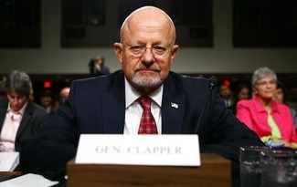
Was Congress Informed?
James Clapper, National Intelligence Director denies under oath that NSA is collecting information on millions of Americans. At least not “wittingly.”

Slide 15
The Chilling Effect
The First Amendment prohibits government actions that create a chilling effect on speech.
Lamont v. Postmaster General, 381 U.S. 301 (1965)
The "chilling effect" referred to in the case was a "deterrent effect" on freedom of expression—even when there is no law explicitly prohibiting it
How much speech does not occur now that we know of the monitoring and storage of all electronic communications?

Slide 16
The Constitution, Spying & Terrorism
Society needs to decide how much intrusion on its liberty it is willing to accept in the name of “safety” and “security.”
Since 9/11, the Patriot Act & NSA domestic spying, the boundaries of personal liberty are shrinking dramatically.
People are more likely to die from these other causes than from terrorism:
Killed by a Police Officer (8x more likely)
Choking on your own vomit (9x more likely)
Airline Travel (11,000x more likely)

Slide 17
Conclusions
The future of Free Speech on the Internet will depend on the willingness of American citizens to take a stand and demand their privacy rights.
NSA Spying and Patriot Act abuses have forced a discussion about how much liberty we are willing to give up to feel safe
The U.S. is at a critical crossroad: Will it continue to be the home of the brave, or the government shelter of the weak?

Slide 18
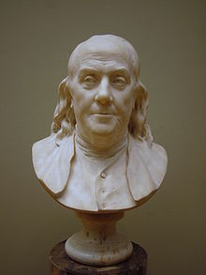
Ending Quote
“Those who would give up Essential Liberty to purchase a little Temporary Safety, deserve neither Liberty nor Safety.”
Ben Franklin

