Slide 1
Constitutional Restrictions on Erotic Speech Under the First Amendment
Presented By: Lawrence G. Walters
of Walters Law Group
Larry@FirstAmendment.com
Walters Law Group
Metro-Orlando Florida
PH: 407.975.9150
www.FirstAmendment.com

Slide 2
Introduction
* Presenter Background
* Historical Hostility Toward Erotic Media
* Recent Societal / Technological Changes
* Goals for Presentation

Slide 3
The Video Store Wars
- 1980’s brought about dramatic changes in the production and distribution of erotica.
- The VCR allowed individuals to view adult material in the privacy of their own home.
- Production and distribution costs cut.
- Content became more risqué.
- Obscenity prosecutions proliferated.

Slide 4
Restrictions on Erotic Speech
Sexually oriented speech – Overview:
Unprotected erotic speech:
Obscenity
Child pornography
Adult pornography – presumed to be protected. Ashcroft v. ACLU.
Exposure to Minors
Indecency Laws
Violence

Slide 5
Presumption of Protection
Presumption of First Amendment protection even if speech is erotic in nature
Only exceptions are Obscenity and Child Pornography
Issues with Possession:
Obscenity can be legally possessed in the home; Stanley v. Georgia, 394 U.S. 557 (1969)
Possession of underage material is still illegal – Split decisions:
Viewing v. Downloading
Knowledge of existence of underage material / Constructive Possession

Slide 6
More than Words…
First Amendment protects more than mere words
Expression v. speech
Activity designed to convey a message is protected:
Nude Dancing
Flag Burning
Production of Erotica?
Probably protected activity
CA and NH are the only states where production specifically deemed legal
Other states – prostitution is an open question
But Note: text and cartoons have been deemed obscene

Slide 7
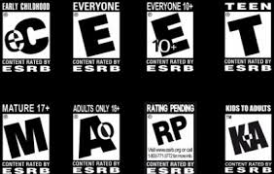
Violent Speech
Not sufficient to justify restrictions on expression
Brown v. Entertainment Merchants Assn., 564 U.S. --, 131 S.Ct. 2729 (2011)(invalidating California’s violent video game law)
U.S. v Stevens, 559 U.S. 460, 130 S.Ct. 1577 (2010)
Prohibition on “Animal cruelty videos”
Government’s attempt to deal with problem was immensely overbroad
Q: Sadomasochistic content.
Sentencing enhancements – federal level
Issues with obtaining valid model release

Slide 8
Obscenity
Miller Test
Miller v. California, 413, U.S. 15 (1973)
3 prongs
Whether “the average person, applying contemporary community standards,” would find that the work, taken as a whole appeals to the prurient interest
Whether the work depicts or describes, in a patently offensive way, sexual conduct specifically defined by applicable state law
Whether the work, taken as a whole lacks serious literary, artistic, political or scientific value
All 3 prongs must be satisfied for the work to be considered obscene

Slide 9
Contemporary Federal Obscenity Cases
US. v. Extreme Associates, 431 F.3d 150 (3d Cir. 2005) - Husband and wife defendants sentenced to a year in prison for creating allegedly obscene material and mailing it across state lines
United States v. Little, 365 F. App’x 159 (11th Cir. 2010) – Adult content producer, Max Hardcore, sentenced to five years in prison for obscenity violations in the Middle District of Florida
United States v. Stagliano, 729 F.Supp.2d 215 (D.D.C. 2010) – obscenity case against adult content producer, John Stagliano, ultimately dismissed in an embarrassing loss to the DOJ

Slide 10
Florida Obscenity Cases
Tammy Robinson
Chris Wilson
Clint McGowan
Theresa Taylor (a.k.a. Kimberly Kupps)

Slide 11
THE IMPACT OF THE INTERNET
Is the Internet changing views/opinions on erotic material?
Technology permits widespread/accessible use
Laptop, tablet and smart phone consumption soaring – allows for greater user privacy
The mainstreaming of erotica

Slide 12
Obscenity in the Digital Age
Decline in prosecutions, but still a reality
AG Eric Holder disbanded Obscenity Prosecution Task Force
DOJ: choose to concentrate on “most egregious” cases → those involving child exploitation
Difficulties with applying Miller Test in Digital Age
What is the ‘community’?
Basis for obscenity restrictions undermined by private transmission
Morality in Media donations sharply decline
Feminists focus more on education

Slide 13
Child Pornography
18 U.S.C. Ch. 110: Sexual Exploitation & Other Abuse of Children
§2256 – Defines child pornography
§§ 2251; 2252, 2252A - Illegal to produce, sell, traffic, possess, receive, “visual depiction of a minor engaged in sexually explicit conduct” – Definitions governed by the Dost Factors (U.S. v. Dost, 636 F. Supp. 828 (S.D. CA 1986)
Elements, generally:
Prosecution NOT required to prove defendant’s knowledge of minor’s age in prosecutions against producers
Effectively makes sexual exploitation statutes strict liability offenses
Regardless of consent or misrepresentation by minor
But see; U.S. v. X-Citement Video 513 U.S. 64 (1994) – ‘knowledge’ requirement ‘read into’ the statute regarding all but original producers of the material
§2258A-E – Reporting requirements for online service providers regarding underage material and exploitation activities
Major Cases
NY v. Ferber 458 U.S. 747 (1982)
Osborne v. Ohio 495 U.S. 103 (1990)

Slide 14
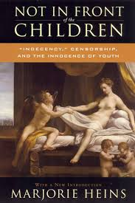
Indecency Laws
Federal indecency regulations
Communications Decency
Act of 1996 (“CDA”)
47 U.S.C.§ 223 – “Anti-Indecency Provision”
Reno v. ACLU, 521 U.S. 844 (1997) – SCOTUS struck down the anti-indecency provision of CDA as unconstitutional under the First Amendment (unanimous decision)
Government’s first attempt to require blocking of access by minors to adult websites
SCOTUS struck down 47 U.S.C. § 223 as unconstitutional under the First Amendment as an overbroad, content based restriction on speech
Law created criminal penalties for transmissions of indecent communications

Slide 15
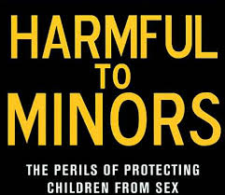
Harmful to Minors
COPA [47 U.S.C. s. 231(a)(1) - Child Online Protection Act – 1998]
Passed as a response to Reno v. ACLU with intent to restrict minors’ access to any online material defined as “harmful to minors”
Penalties: up to $50K in fines and 6 months’ imprisonment for knowingly posting content that was harmful to minors on the internet for commercial purposes
Made it illegal only to operate a commercial site (as opposed to a private chat room) that made sexually explicit material available to minors
Such sexually explicit material had to be considered “harmful to minors” not just “indecent”

Slide 16
Ashcroft v. ACLU
Ashcroft v. ACLU, 535 U.S. 564 (2002) – COPA struck down after a decade-long litigation battle
1999 – Eastern Dist. of PA judge blocked enforcement of COPA and the ruling was appealed to the Third Circuit
2000 – Third Circuit affirms unconstitutionality of COPA, finding that could not apply “contemporary community standards” to the Internet and the case was appealed to SCOTUS
2002 – SCOTUS vacated the lower court’s opinion and remanded the case for further proceedings on the constitutional ramifications of COPA
2003 - On remand the Third Circuit again affirmed the district court’s preliminary injunction and a second appeal to SCOTUS is attempted
2004 – SCOTUS found that too much time elapsed from the original appeal for the court to make a decision so the case was sent back to the district court for a full trial on the merits
2007 – On remand, the district court declared COPA unconstitutional [American Civil Liberties Union v. Gonzales, 478 F. Supp. 2d 775 (E.D. Pa. 2007)]
2008 – The Third Circuit again concurred with the findings of the trial court and found the law unconstitutional
2009 – SCOTUS refuses to hear the appeal, effectively striking COPA from the US code, with the law never having taken effect.

Slide 17
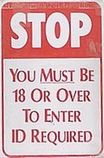
Efforts to Protect Minors
Website Operator Obligations Regarding Minors
New legal challenges for protecting minors as technology evolves
Access to material
Age verification: landing/splash page, active assent confirming user’s age
Erotic Content Producer Obligations
18 U.S.C. 2257 – Records Keeping & Labeling -(Compliance / Exemptions)
Imposes records keeping and labeling obligations on those who produce or publish sexually explicit material
Exemption: Social Networking sites not acting as a “producer” – depends on content publication/upload procedure
Legal Challenge – FSC v. Holder, 677 F.3d 519 (3d. Cir. 2012). Decision pending.

Slide 18
Indecency Laws – State Level
American Book Sellers Foundation for Free Expression v. Dean, 202 F. Supp. 2d 300 (D. Vt. 2002)
PSINet, Inc. v. Chapman, 167 F. Supp. 878 (W.D. Pa. 2001), question certified, 317 F.3d 413 (4th Cir. 2003)
Cyberspace Communications, Inc. v. Engler, 142 F. Supp. 2d 827 (E.D. Mich. 2001)
ACLU v. Johnson, 194 F.3d 1149 (10th Cir. 1999)
American Libraries Association v. Pataki, 969 F. Supp. 160 (S.D.N.Y. 1997)
Center for Democracy & Technology v. Pappert, 337 F. Supp. 2d 2006 (E.D. PA 2004)
Southeast Booksellers Ass’n v. McMaster, 371 F. Supp. 2d 773 (D.S.C. 2005)

Slide 19
The Chilling Effect
The First Amendment prohibits government actions that create a chilling effect on speech. Lamont v. Postmaster General, 381 U.S. 301 (1965) [mere existence of a law requiring return of post card requesting delivery of certain categories of controversial mail]
The "chilling effect" referred to in the case was a "deterrent effect" on freedom of expression—even when there is no law explicitly prohibiting it
What is the impact of other targeted regulatory laws?
Section 2257 Records Keeping
Mandatory Condom Laws – LA County
Employee Records Laws in Adult Businesses

Slide 20
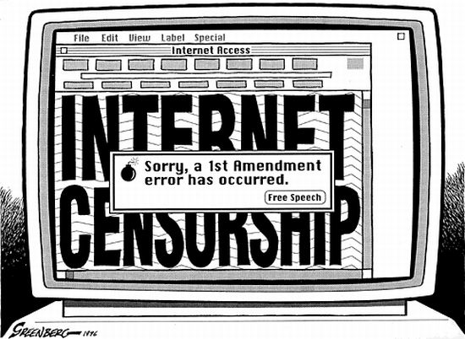
CENSORSHIP, INTNL.
Some countries have imposed bans on various forms of erotic speech – unconstitutional in the United States
Porn Bans: Iceland, EU, UK
Reasoning for bans:
Personal harm to females participating (Iceland)
Social harm to children exposed to it (EU / UK)
Unlikely to be effective:
Logistical nightmare because dealing with technology and definitions
Black Market
Alternative Sources for Material
Prohibitions might change behavior but change in behavior does not mean alleged “problem” was solved – merely proves that it has gone underground

Slide 21
The Evils of Censorship
“There is more than one way to burn a book. And the world is full of people running about with lit matches.”
-Ray Bradbury
Censorship reflects society's lack of confidence in itself.
It is a hallmark of an authoritarian regime.
~Potter Stewart

Slide 22
Conclusions
Erotic entertainment has become ingrained in the mainstream of society
Internet usage soaring in the U.S. and globally
Sexual expression is a human right
Free society is about choice:
Free speech rights
Sexual intimacy
Personal autonomy
The right to be left alone

